Slide 1
Change-making:
Question: Given an integer array that represents coin denominations. Determine
the fewest number of coins you need to achieve a total given amount
[1 , 2, 5 ]
[ 5 ]
[ 2 ]
1
Amount = 11
Amount = 6
Amount = 0
1
1
1
1
1
2
1
1
1
2
2
5
5
1
1
2
2
1
1
Notes:
Ahmed Mostafa Aly

Slide 2
Brute Force:
[1 , 2, 5 ]
Amount = 11

Slide 3
Greedy Approach:
Greedy : We need minimum coins, so we will be greedy and try
to choose the coin with maximum denominations first.
1
5
2
1
5
6
9
Amount = 11
Amount = 11

Slide 4
Dynamic Programing:
Dynamic programming is a technique for solving problems with overlapping
subproblems.
dynamic programming suggests solving each of the smaller subproblems only once and recording the results in a table from which a solution to the original problem can then be obtained.

Slide 5
Building an efficient solution:
1
5
6
9
Amount = 11

Slide 6
Building an efficient solution:
1
5
6
9
Amount = 11
amount | 0 | 1 | 2 | 3 | 4 | 5 | 6 | 7 | 8 | 9 | 10 | 11
min coins needed

Slide 7
Building an efficient solution:
1
5
6
9
Amount = 11
amount | 0 | 1 | 2 | 3 | 4 | 5 | 6 | 7 | 8 | 9 | 10 | 11
min coins needed

Slide 8
Building an efficient solution:
1
5
6
9
Amount = 11
amount | 0 | 1 | 2 | 3 | 4 | 5 | 6 | 7 | 8 | 9 | 10 | 11
min coins needed

Slide 9
Building an efficient solution:
1
5
6
9
Amount = 11
amount | 0 | 1 | 2 | 3 | 4 | 5 | 6 | 7 | 8 | 9 | 10 | 11
min coins needed

Slide 10
Building an efficient solution:
1
5
6
9
Amount = 11
amount | 0 | 1 | 2 | 3 | 4 | 5 | 6 | 7 | 8 | 9 | 10 | 11
min coins needed

Slide 11
Building an efficient solution:
1
5
6
9
Amount = 11
amount | 0 | 1 | 2 | 3 | 4 | 5 | 6 | 7 | 8 | 9 | 10 | 11
min coins needed

Slide 12
Building an efficient solution:
1
5
6
9
Amount = 11
amount | 0 | 1 | 2 | 3 | 4 | 5 | 6 | 7 | 8 | 9 | 10 | 11
min coins needed

Slide 13
Building an efficient solution:
1
5
6
9
Amount = 11
amount | 0 | 1 | 2 | 3 | 4 | 5 | 6 | 7 | 8 | 9 | 10 | 11
min coins needed

Slide 14
Building an efficient solution:
1
5
6
9
Amount = 11
amount | 0 | 1 | 2 | 3 | 4 | 5 | 6 | 7 | 8 | 9 | 10 | 11
min coins needed

Slide 15
Building an efficient solution:
1
5
6
9
Amount = 11
amount | 0 | 1 | 2 | 3 | 4 | 5 | 6 | 7 | 8 | 9 | 10 | 11
min coins needed

Slide 16
Building an efficient solution:
1
5
6
9
Amount = 11
amount | 0 | 1 | 2 | 3 | 4 | 5 | 6 | 7 | 8 | 9 | 10 | 11
min coins needed

Slide 17
Building an efficient solution:
1
5
6
9
Amount = 11
amount | 0 | 1 | 2 | 3 | 4 | 5 | 6 | 7 | 8 | 9 | 10 | 11
min coins needed

Slide 18
Python code implementation:
def changeMaking(D, n):
m = len(D)
F = [0] * (n + 1)
for i in range(1, n + 1):
temp = float('inf')
for j in range(1, m + 1):
if i >= D[j - 1]:
temp = min(F[i - D[j - 1]], temp)
F[i] = temp + 1
return F[n]
print(changeMaking([1, 3, 4], 6))

Slide 19
Pseudo code implementation:
ALGORITHM ChangeMaking(D[1..m], n)
//Applies dynamic programming to find the minimum number of coins
//of denominations d1< d2 < . . . < dm where d1 = 1 that add up to a
//given amount n
//Input: Positive integer n and array D[1..m] of increasing positive
// integers indicating the coin denominations where D[1]= 1
//Output: The minimum number of coins that add up to n
F[0]←0
for i ←1 to n do
temp←∞; j ←1
while j ≤ m and i ≥ D[j ] do
temp ←min(F [i − D[j ]], temp)
j ←j + 1
F[i]←temp + 1
return F[n]

Slide 20
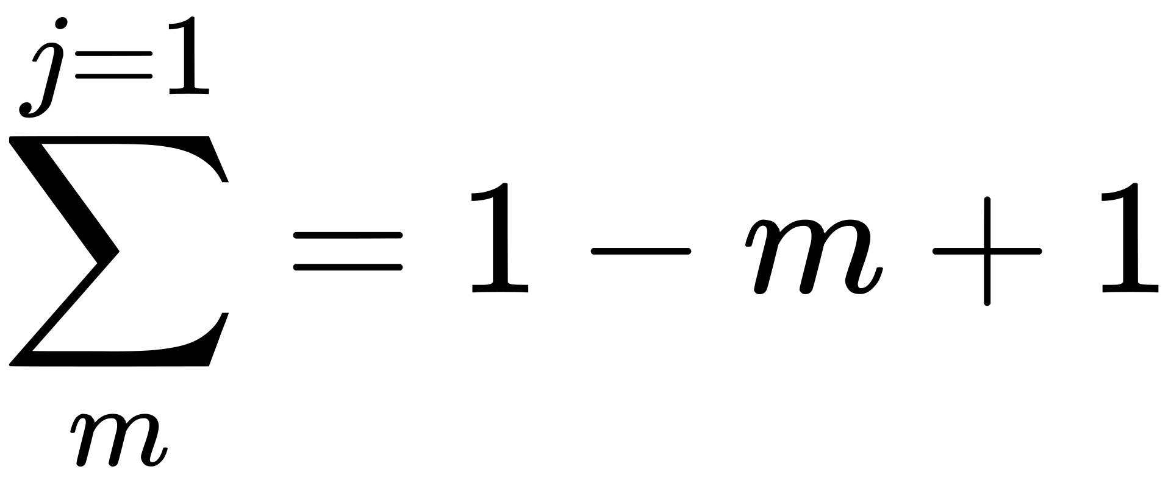
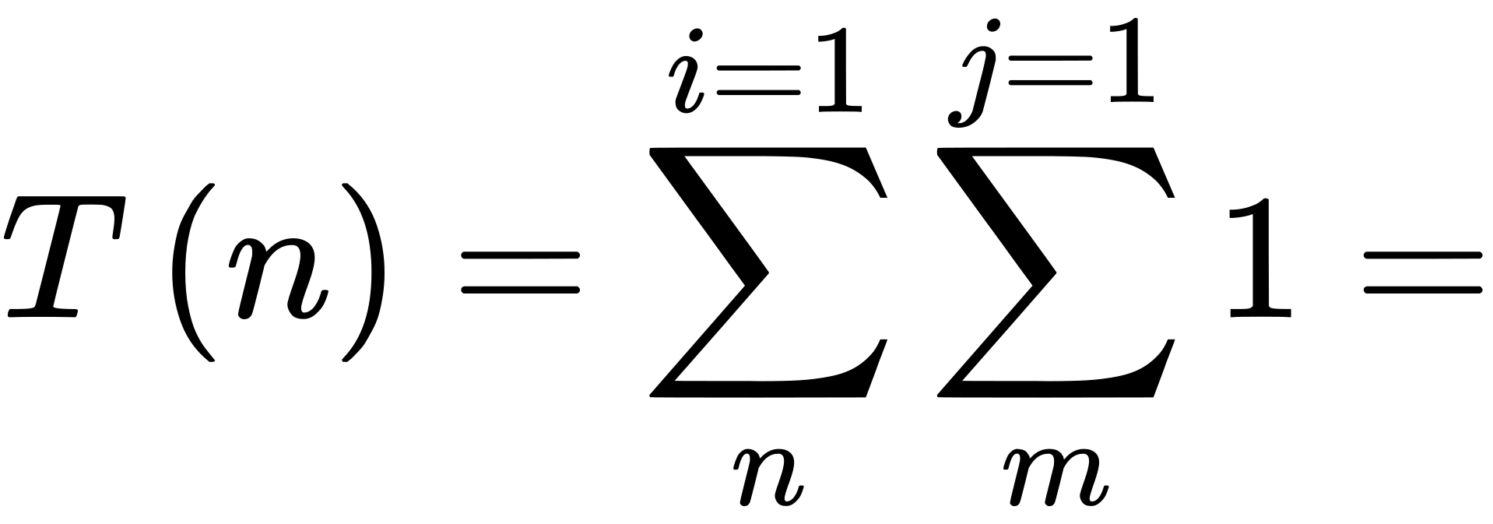
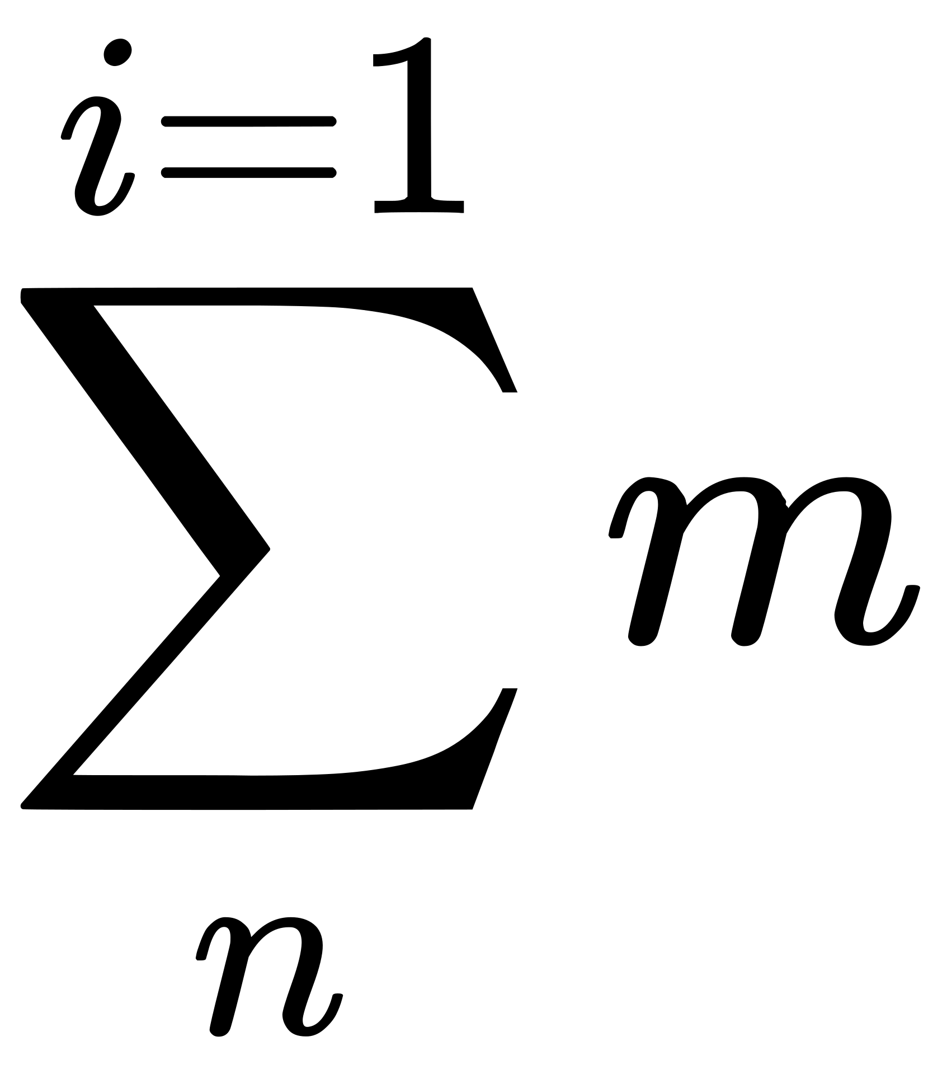
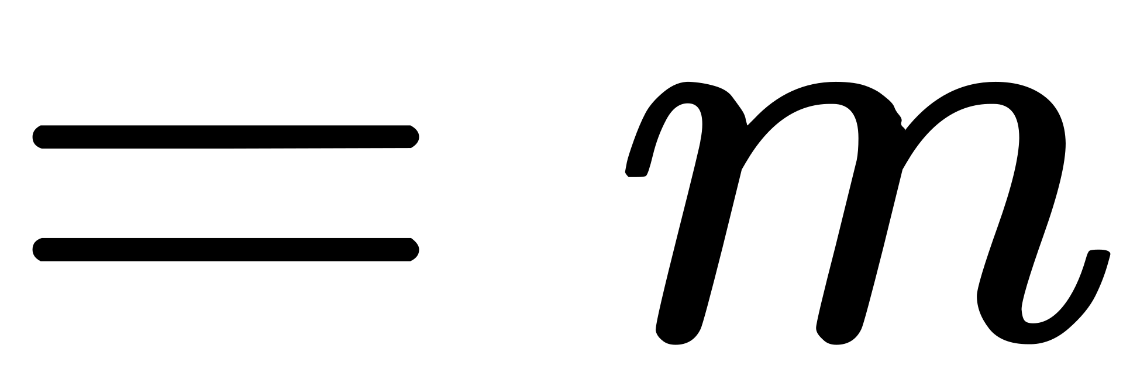
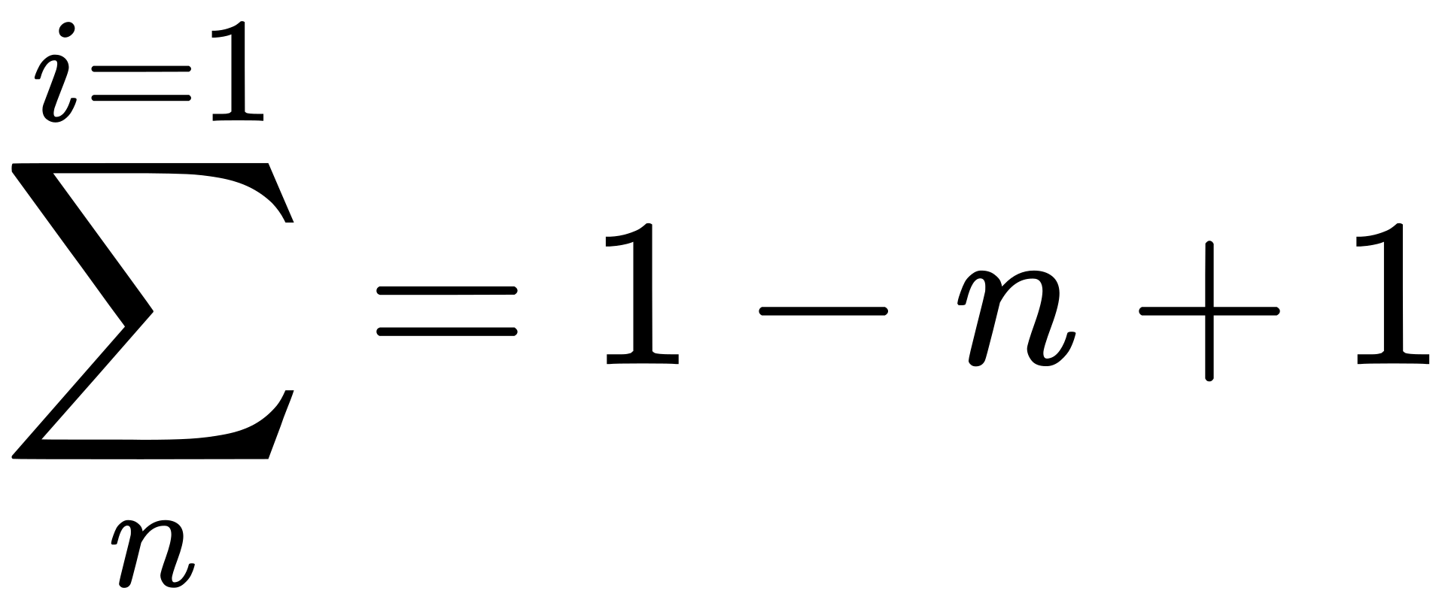
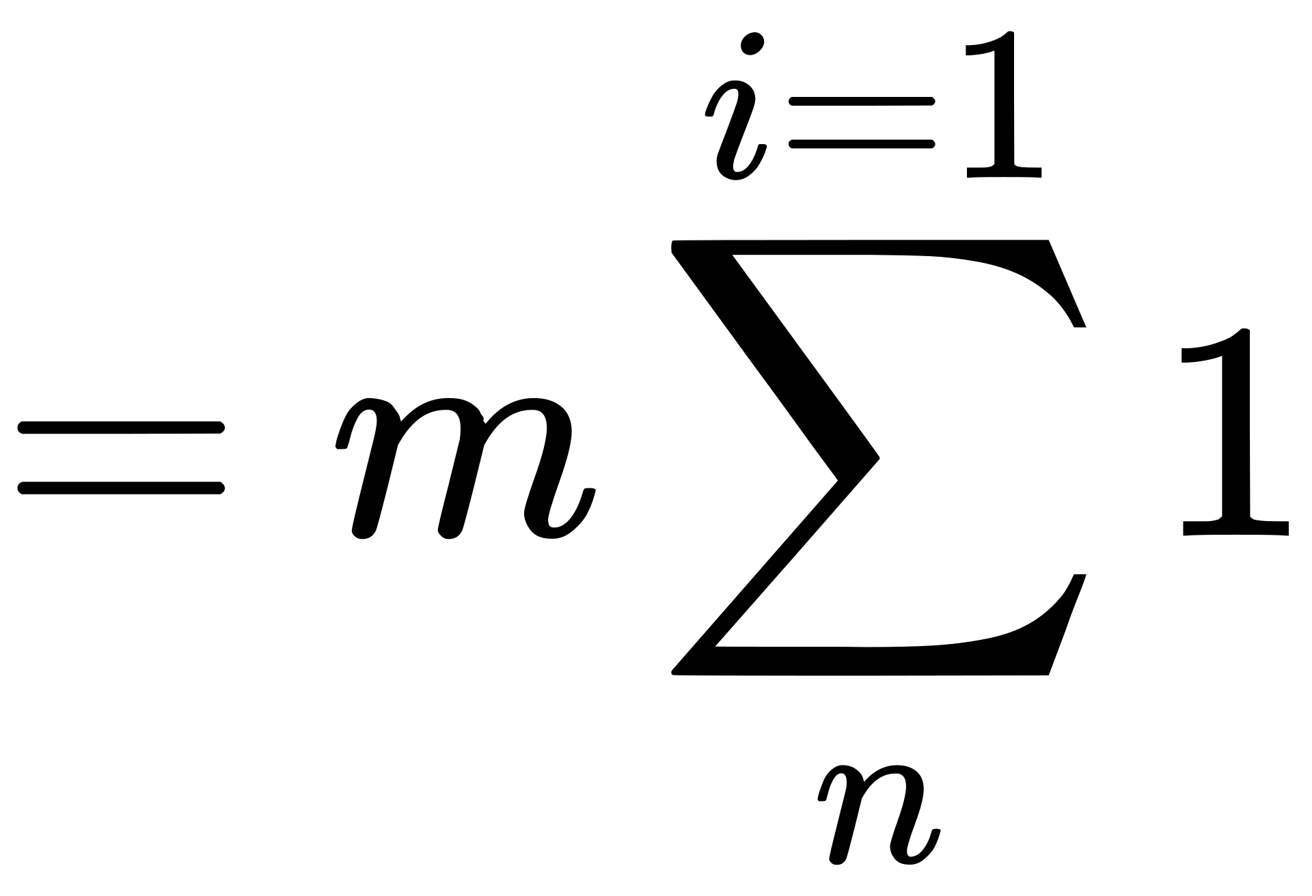
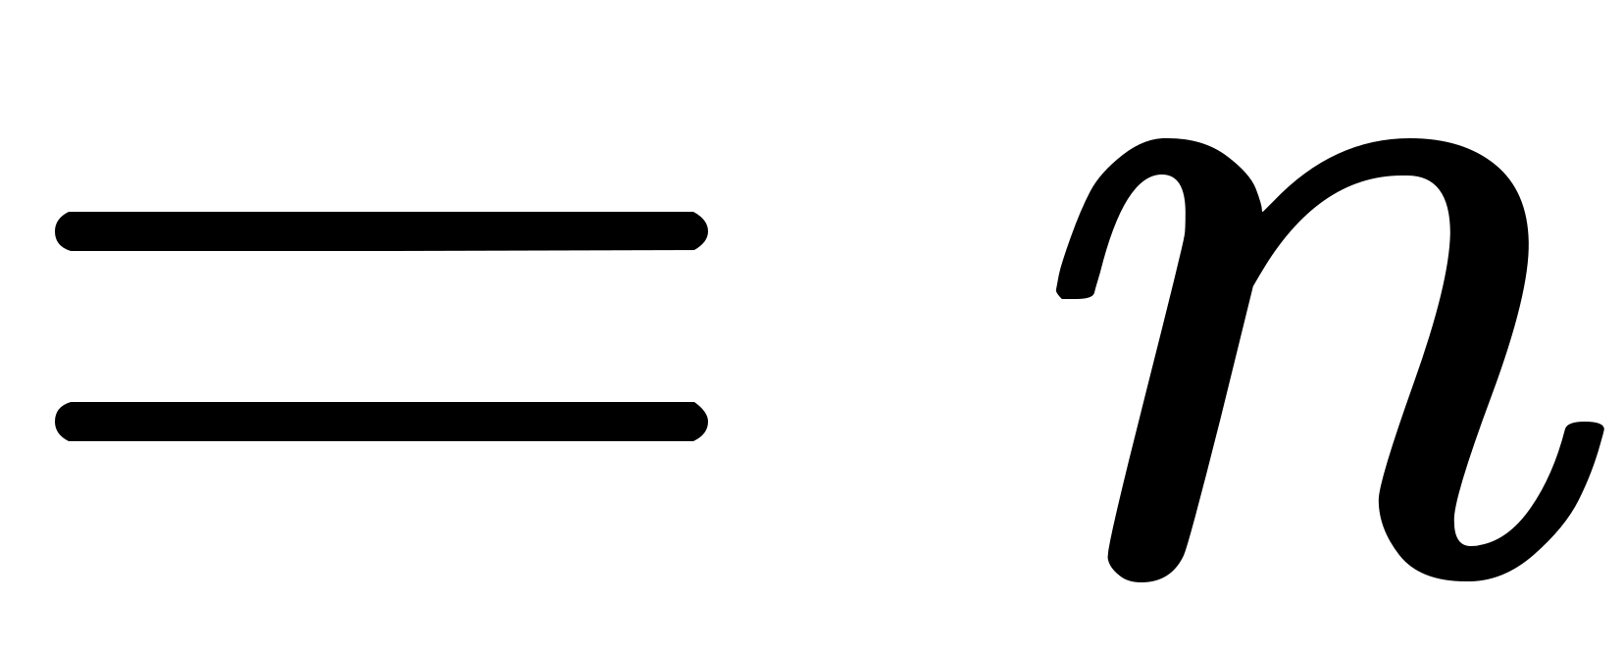
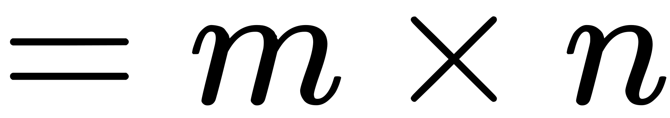
Analysis:
Add a little bit of body text

Slide 21
Analysis:
The time complexity of this code is O(n * m),
where n is the value for which we want to determine the minimum number of coins, and m is the number of denominations.
This is because, in the worst-case scenario, the nested for loop iterates over every possible denomination (m) for every target value (n).

